Slide 1

Learning Deep Learning
@rahul_a_r
IBM Research AI

Slide 2
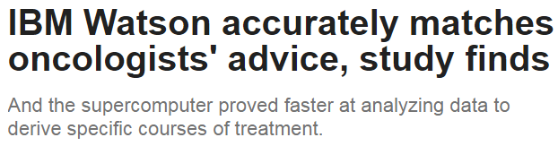
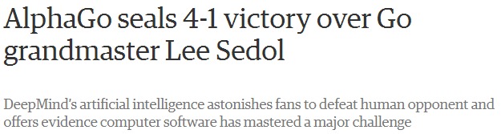
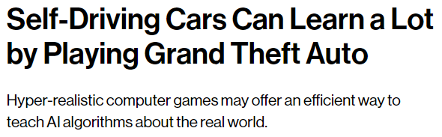
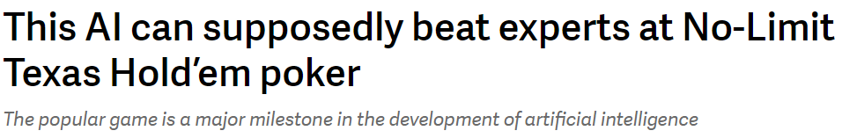
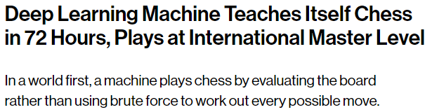
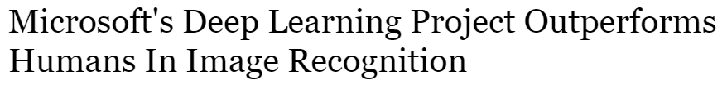
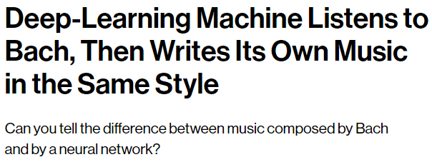


Deep Learning everywhere!
Notes:
Open move: chess->20, go->361

Slide 3
What’s inside?
Preliminaries
Data Analysis Pipeline
Data Splitting
MNIST Dataset
Neural Networks
Perceptron
Multilayer Perceptron
Gradient Descent
Deep Neural Networks
Autoencoders
Notes:
I will only go through the basics
Will give you only intuitions and not formal proofs
These are only the building blocks
Today’s networks use them (or their variations) to build more complex networks

Slide 4
Preliminaries

Slide 5
Data Analysis Pipeline
Gather Data
Clean Data
Extract Features
Learn
Predict
Extract Features: conversion of raw data into some useful format
Usually transforming to a higher/lower dimension
Eg: Kernels, PCA, LSA, etc
Learn: Can take multiple forms
Supervised: classification, regression
Unsupervised: clustering
Reinforcement

Slide 6
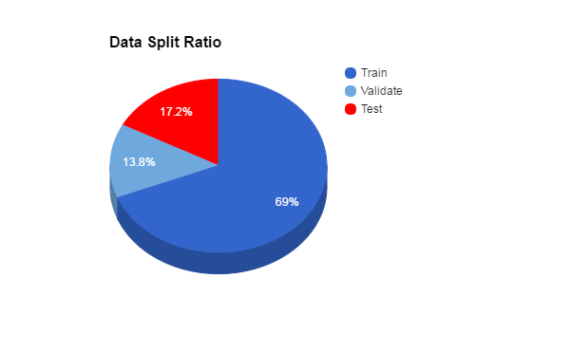
Data Splitting
Data is generally divided into 2 disjoint sets: Train and Test
Training data is used for learning
It can be further split into a validation set which acts as a test set during learning
Test data is used to compute how well the model has learned
Ideal ratio = 80:20
Start learning
Test
Learning process

Slide 7
Feature Extraction
Useful information in data is usually hidden
We need some mechanism to keep only the useful parts
Example: Predict prices of houses in Bangalore
Area (in sqft) | Location | Rooms | Wall color | Price (in crores)
1200 | Whitefield | 2 | Blue | 1.00
1900 | Indiranagar | 3 | Grey | 2.50
2400 | Jayanagar | 4 | Yellow | 3.50
1900 | Banashankari | 3 | Red | 1.50
800 | Lavelle Road | 1 | Green | 1.50

Slide 8
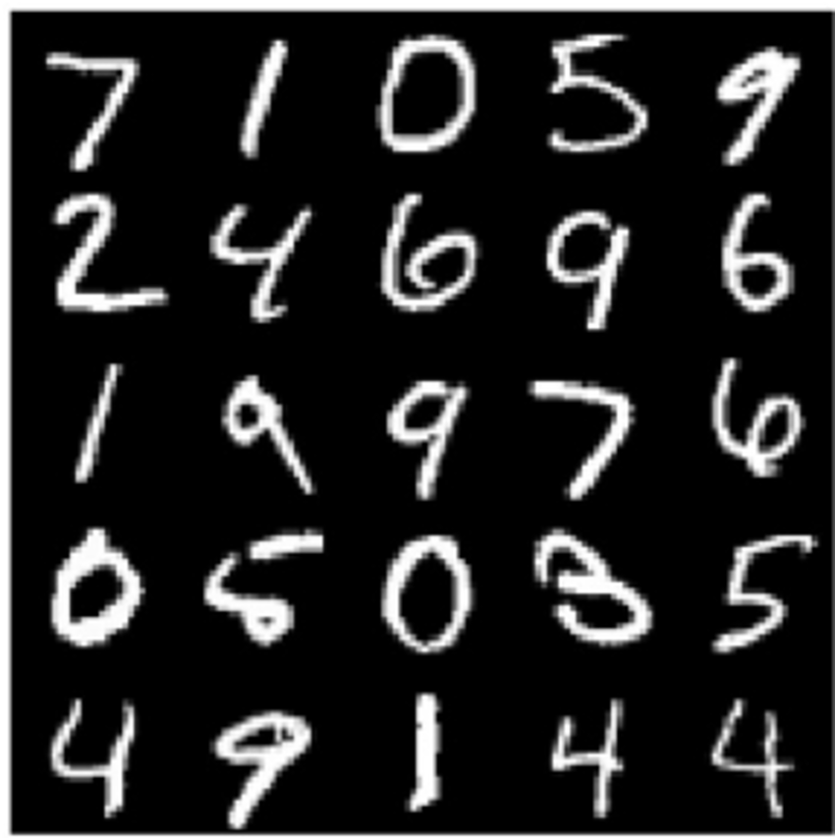

MNIST dataset
Let’s start with the MNIST Dataset
Each data point is a 28X28 image
Each image is a handwritten digit between 0-9
There are 60,000 training and 10,000 test points
We have to predict the class (0-9) using the other information (784 pixel values)
Each pixel value is in the range 0-256
0
255
Handwritten digits

Slide 9
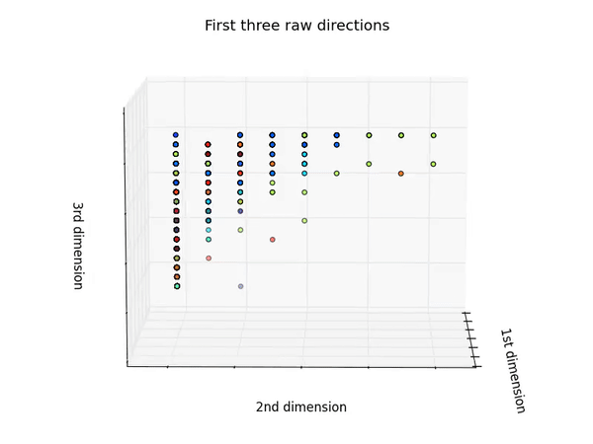
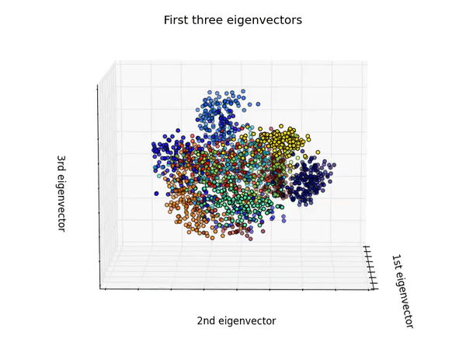
MNIST Dataset

Slide 10
Neural Networks

Slide 11
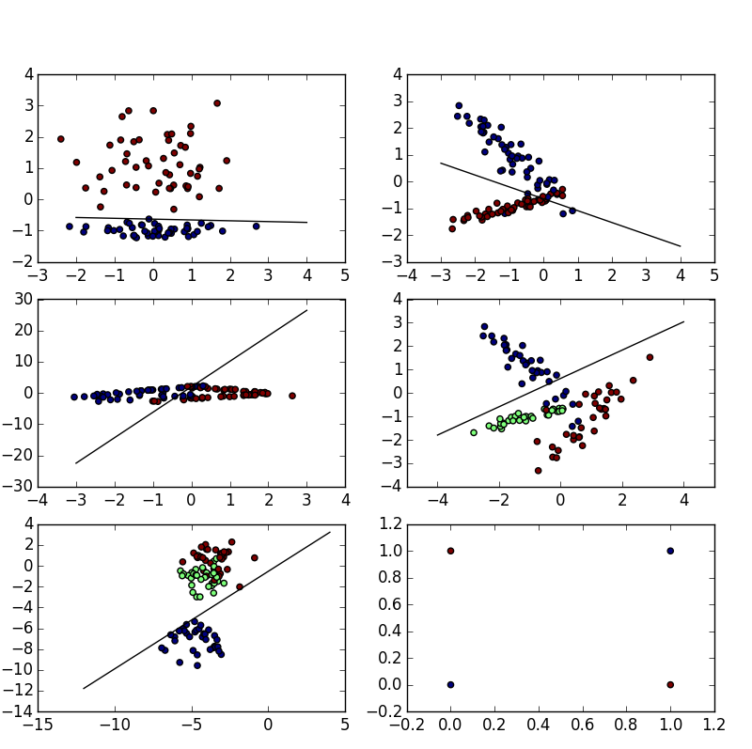
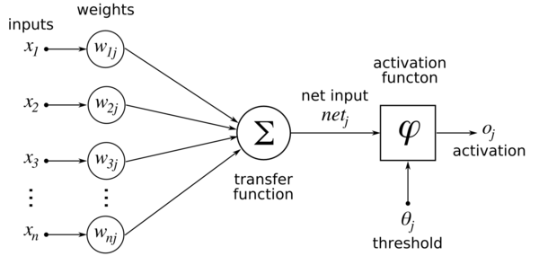
Perceptron

Slide 12
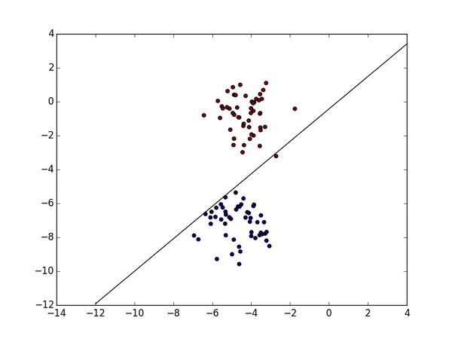
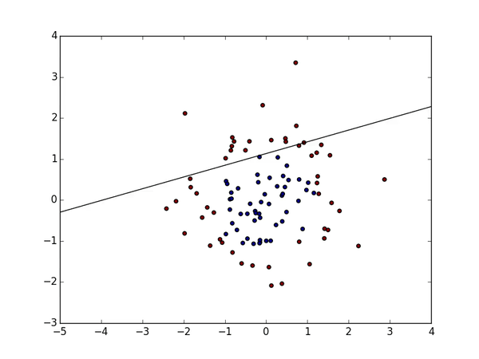
Perceptron

Slide 13
Multilayer Perceptron
b1
Input
b3
Hidden 2
X
W1
W2
W3
y
Output
Hidden 1
b2
Calculate loss and update weights

Slide 14
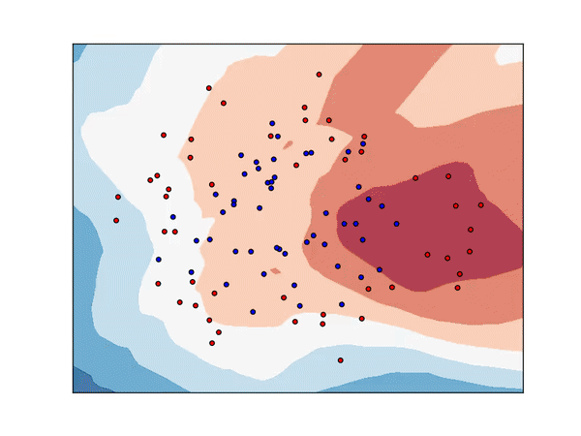
Multilayer Perceptron
Universal Approximator
One hidden layer can approximate any mathematical function
Depth is preferred over width
But how do we train?

Slide 15
Gradient Descent
Network weights are initialized randomly (with some heuristics)
The predicted output is compared to the ideal output and a loss is calculated
Mean squared error
Cross entropy
Log loss, etc.
Our aim is to minimize this loss
Therefore, we perform the following steps repeatedly:
Give inputs to the network and calculate the loss
Determine the gradient of the loss
Slightly change the weights in the opposite direction of the gradient
This must be done for each weight parameter in the network

Slide 16
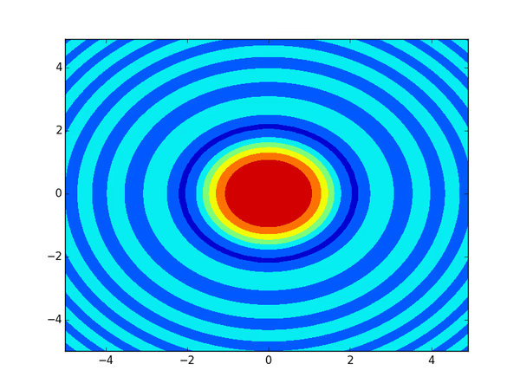
Gradient Descent
W1
W2
W3

Slide 17
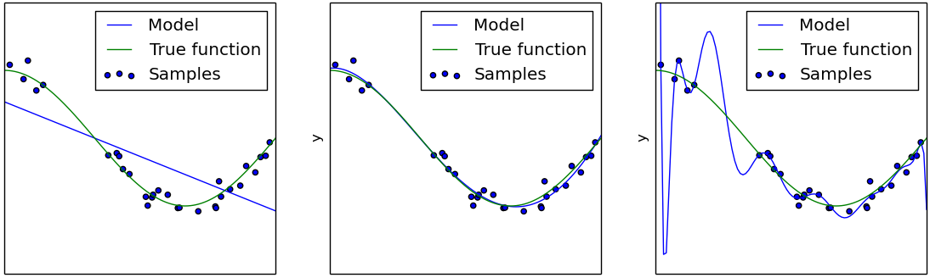
Nutshell definitions
Images courtesy: Scikit Learn [4]
Overfitting: Perfect fit on training data, poor fit on testing data
Underfitting: Poor fit on training data as model is too simple
Regularization: Add penalty terms so that model doesn’t overfit
Vanishing gradient: Gradient become 0 on multiplications
Exploding gradient: Gradient becomes ∞ on multiplications

Slide 18
Deep Neural Networks

Slide 19
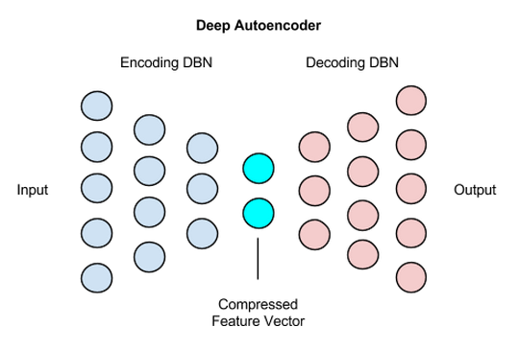
Autoencoders
Input: Data
Output: Reconstructed Data
Each layer acts as one PCA transformation
∴ it can be thought of as non-linear PCA
Innermost layer represents the feature vector
Vanishing/Exploding gradient problem
Images courtesy: DeepLearing4J [3]

Slide 20
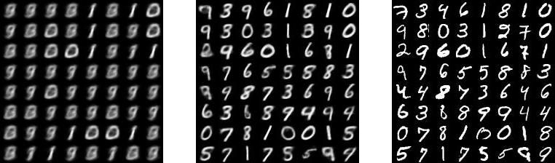
Autoencoders
After 1 epoch
After 9 epochs
Original
Images courtesy: Variational Autoencoders Explained [5]

Slide 21
Hands-on Session

Slide 22
Multilayer Perceptron
b1
Input: 784 (28*28)
b3
ReLU
Hidden 2: 100
ReLU
Softmax
X
W1
W2
W3
y
[1x784]
[784x300]
[300x100]
[100x10]
[1x10]
Output: 10 classes
Hidden 1: 300
b2
Stochastic Gradient Descent
Loss: Categorical Cross entropy

Slide 23
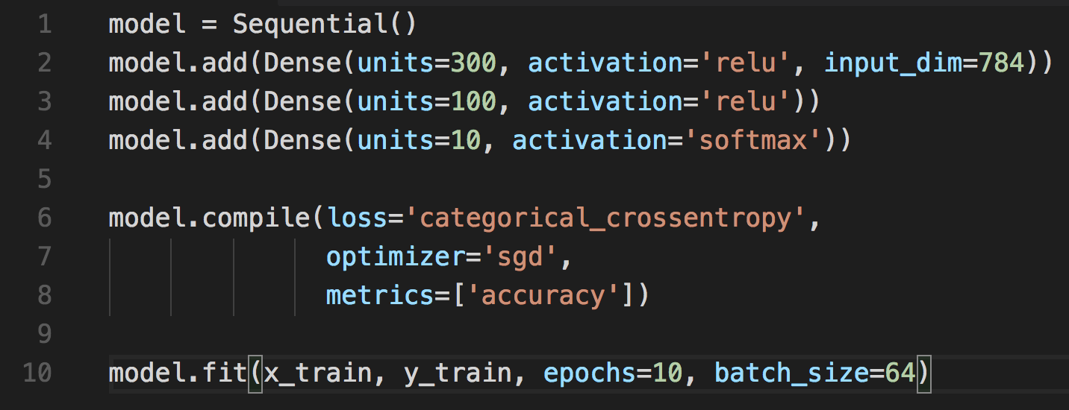
Keras code

Slide 24
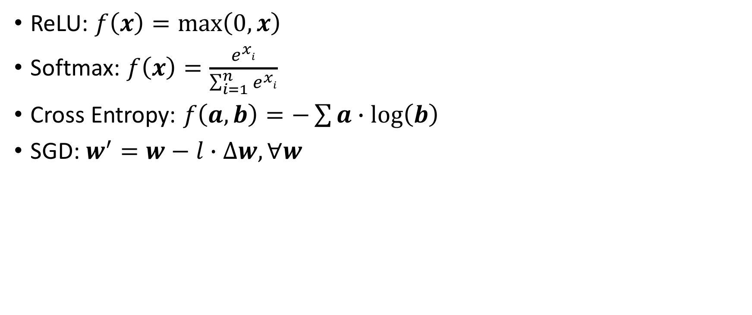
Formulae
ReLU: $f\left(x\right)=\max\left(0, x\right)$
Softmax: $f\left(x\right)=\frac{e^{xi}}{\sum_{i=1}^{n}{e^{xi}}}$
Cross Entropy: $f\left(a, b\right)=−\sum{a∙\log\left(b\right)}$
SGD: $w^{′}=w−l∙∆w, ∀w$
Time to code!

